Slide 1
DEMO DAY | FINAL PROJECT
BANK CUSTOMER
CHURN PREDICTION
From raw customer data to a deployed machine-learning application
)TEAM 6(
HIBA MAHMOUD
Zaid Alshawabkeh
ZAKARIA OMRAN
Aya Marwan
Machine Learning • Model Evaluation • Streamlit Deployment
https://github.com/hibaalshalabi/Bank-Customer-Churn-Prediction.git

Slide 2
INTRODUCTION
Project Overview
THE GOAL
THE APPROACH
THE OUTPUT
Predict which bank customers are more likely to leave before they churn.
Clean, explore and prepare customer data, compare ML models, then deploy the selected model.
A Stay / Leave prediction and churn probability through a Streamlit web app.
PROJECT JOURNEY
01
02
03
04
05
06
07
08
Inspect
→
Clean
→
Explore
→
Engineer
→
Split
→
Train
→
Evaluate
→
Deploy
BANK CUSTOMER CHURN PREDICTION | DEMO DAY

Slide 3
Dataset Description
A structured dataset containing 10,000 bank customer records, including demographic, financial, and account-related information. It is used to identify and predict customer churn.
Key Features
Demographics
Financial
Account & Behavior
Age, Gender, Geography
CreditScore, Balance, EstimatedSalary
Tenure, NumOfProducts, HasCrCard, IsActiveMember
TARGET VARIABLE – EXITED
PROJECT OBJECTIVE
0 = Customer retained.
1 = Customer churned.
Apply machine learning classification algorithms to predict customer churn and identify customers at risk of leaving the bank.

Slide 4
INTRODUCTION
Business Problem & Project Objective
BUSINESS PROBLEM
Banks may lose customers without identifying their intention to leave early enough to respond.
PROJECT QUESTION
PREDICTION TARGET
Can customer account information help predict whether a customer will leave the bank?
Exited is the binary target: 0 = stayed, 1 = exited.
Business value: identify higher-risk customers and support focused retention campaigns.
BANK CUSTOMER CHURN PREDICTION | DEMO DAY

Slide 5
INTRODUCTION
Dataset Overview & Source
Sourced from Kaggle and preprocessed to mirror real-world data challenges.
DATA SOURCE (KAGGLE)
CUSTOM PREPROCESSING
Original Churn Modelling dataset containing 10,000 customer records and key demographic features.
https://www.kaggle.com/datasets/shrutimechlearn/churn-modelling
Introduced real-world data noise and missing values to rigorously test cleaning, imputation, and feature engineering pipelines.
Data status: Custom-modified dataset prepared for robust data cleaning and model training.
BANK CUSTOMER CHURN PREDICTION | DEMO DAY

Slide 6
DATA OVERVIEW
Milestone 1 — Dataset Overview
Initial data were inspected before any records or columns were removed.
10,018
14
550
18
Rows at import
Features at import
Missing cells
Exact duplicate rows
Raw dataset
Including the target
Across 3 numeric columns
Detected before cleaning
Target variable
Missing values found
Exited = 0
Customer stayed
CreditScore: 200
Exited = 1
Customer exited / churned
Age: 250
EstimatedSalary: 100
BANK CUSTOMER CHURN PREDICTION | DEMO DAY

Slide 7
DATA EXPLORATION
Dataset Verification & Inspection
# 1. Load the custom-modified dataset
import pandas as pd
df = pd.read_csv("Churn_Modelling_Uncleaned.csv")
# 2. Inspect shape, missing values, and duplicate rows
print("Dataset Shape:", df.shape)
print("\nMissing Values Count:")
print(df.isnull().sum()[df.isnull().sum() > 0])
print("\nDuplicate Rows Count:", df.duplicated().sum())
TERMINAL OUTPUT
Dataset Shape: (10018, 14)
Missing Values Count:
CreditScore: 200 | Age: 250 | EstimatedSalary: 100
Duplicate Rows Count: 18
BANK CUSTOMER CHURN PREDICTION | DEMO DAY

Slide 8
DATA UNDERSTANDING
Milestone 2 — Data Cleaning Decisions
PYTHON: DUPLICATES & NON-PREDICTIVE COLUMNS
df_clean = df.copy()
# Remove duplicate rows
df_clean = df_clean.drop_duplicates().copy()
# Remove identifier columns that do not help predict churn
columns_to_drop = [
col for col in ["RowNumber", "CustomerId", "Surname"]
if col in df_clean.columns
]
df_clean.drop(columns=columns_to_drop, inplace=True)
# Save the cleaned dataset
df_clean.to_csv('Churn_Modelling_Cleaned.csv', index=False)
WHY THESE STEPS?
•
Creating an independent copy (df.copy()) protects original data and prevents unintended modifications.
•
Eliminating 18 duplicate rows ensures model training on unique data.
•
Removing non-predictive identifier columns (RowNumber, CustomerId, Surname) that do not describe customer behavior.
•
Saving cleaned dataset while deferring missing value imputation to training pipeline prevents data leakage.
After basic cleaning
10,000
rows retained
11
Features remain
Missing values are handled inside the pipeline after train/test split.
Processed data saved to 'Churn_Modelling_Cleaned.csv'. Imputation strategy is set up to occur after splitting data into training and testing sets, avoiding data leakage.
BANK CUSTOMER CHURN PREDICTION | DEMO DAY

Slide 9
EXPLORATORY DATA ANALYSIS
Milestone 3 — Exploratory Data Analysis (EDA)
Exploration combined summaries, distribution charts, group comparisons, and correlations.
01
02
03
How many customers churn?
Which groups churn more?
How does age relate to churn?
Target count and percentage
Geography, gender, activity, products
Age distribution and age-group rates
EDA PRINCIPLE
EDA describes patterns and associations. It does not prove that one feature causes a customer to leave.
04
05
06
Do numeric variables move together?
Does balance status matter descriptively?
What looks useful for preparation?
Correlation matrix and heatmap
Zero vs positive balance
Feature engineering and encoding plan
No rows or columns were removed inside the EDA notebook; data cleaning was handled separately.
BANK CUSTOMER CHURN PREDICTION | DEMO DAY

Slide 10
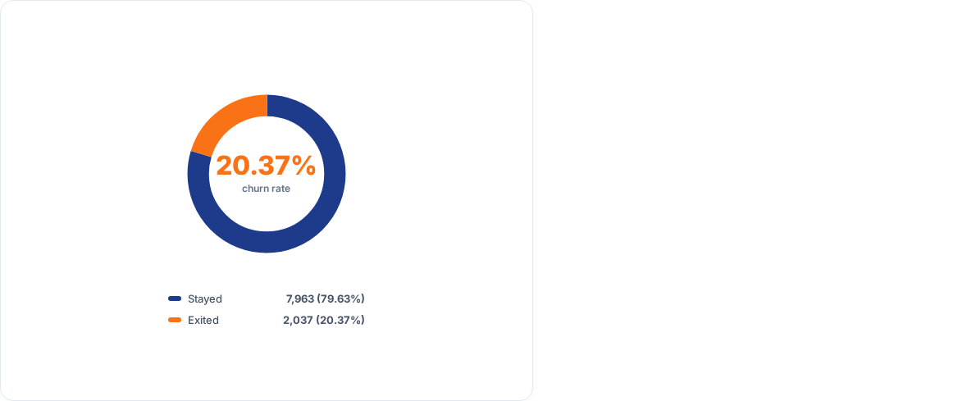
KEY FINDING
About one in five customers churned
After removing exact duplicates, the cleaned analysis set contains 10,000 customers.
2,037
7,963
Customers exited
Customers stayed
20.37%
79.63%
Why it matters
A meaningful minority of customers left, so identifying higher-risk groups can support focused retention efforts. The dataset is imbalanced, so accuracy alone may hide missed churners.
BANK CUSTOMER CHURN PREDICTION | DEMO DAY

Slide 11
BUSINESS INSIGHTS
Churn rates vary across customer groups
Observed churn rates after basic cleaning; these are associations, not proof of cause.
GEOGRAPHY
GENDER
ACTIVITY
Germany
32.44%
Female
25.07%
Inactive
26.85%
Spain
16.67%
Male
16.46%
Active
14.27%
France
16.15%
Germany shows the highest rate.
Female customers show a higher observed rate.
Inactive customers show a higher observed rate.
Interpret patterns carefully: differences may relate to multiple variables, not a single cause.
BANK CUSTOMER CHURN PREDICTION | DEMO DAY

Slide 12
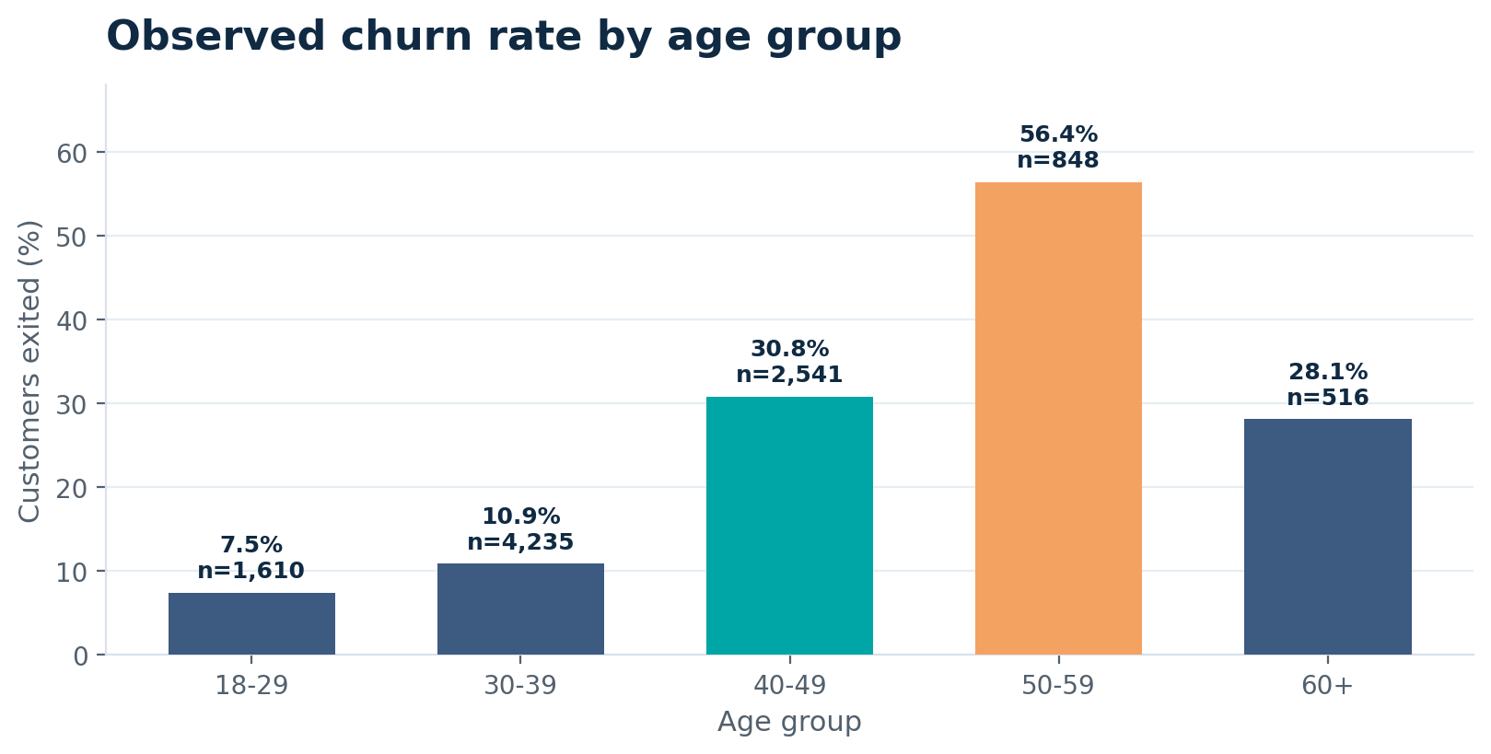
AGE ANALYSIS
Churn is highest among customers aged 50–59
Age groups were created to make age-related patterns easier to compare.
56.37%
Churn rate: age 50–59
848 customers in this group
7.45%
Churn rate: age 18–29
1,610 customers in this group
Observed difference: 48.92 percentage points
BANK CUSTOMER CHURN PREDICTION | DEMO DAY

Slide 13
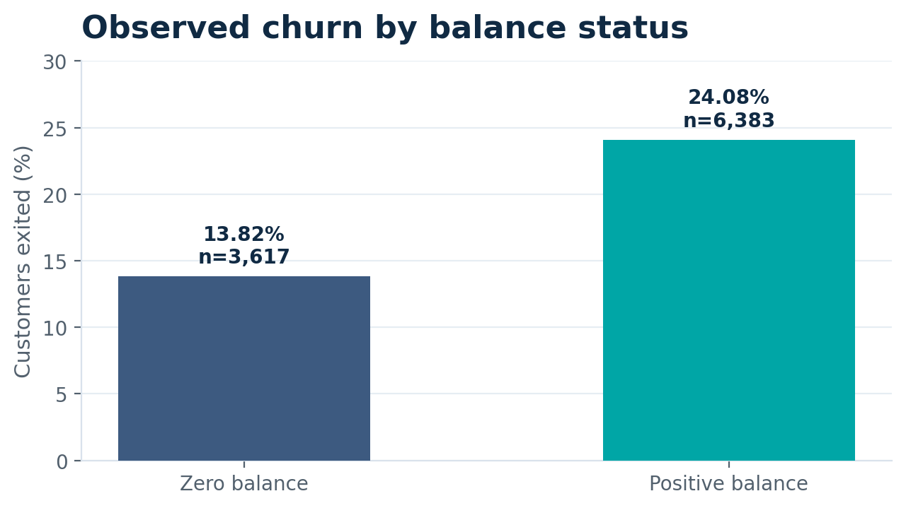
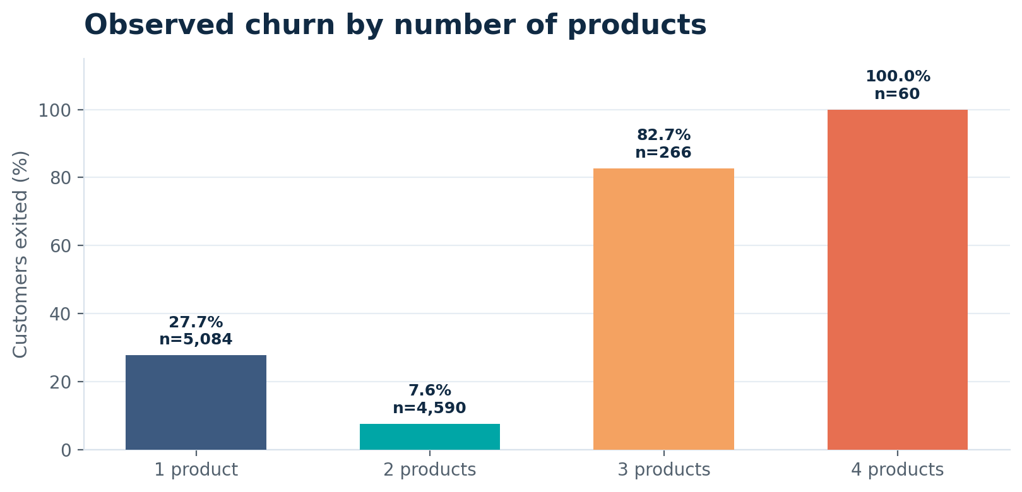
ADDITIONAL SIGNALS
Balance and product count offer more context
Group sizes matter when interpreting very high percentages.
Positive-balance customers showed a higher observed churn rate.
4 products = 100% churn, but only n = 60
BANK CUSTOMER CHURN PREDICTION | DEMO DAY

Slide 14
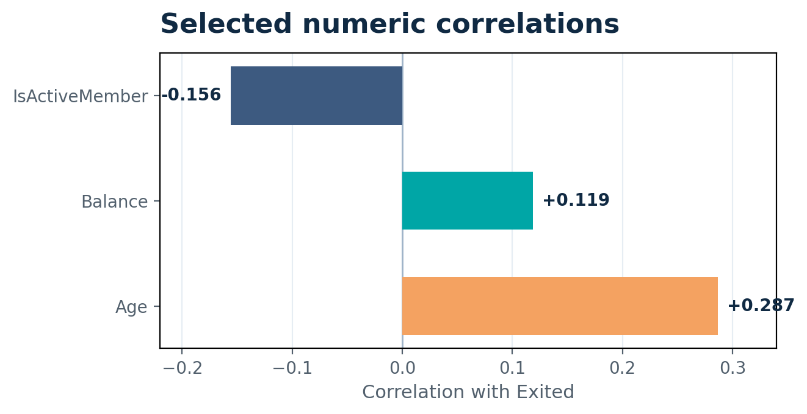
CORRELATION ANALYSIS
Correlation helps describe linear relationships
The heatmap was used to inspect numeric features and their relationship with the target.
Selected correlations with Exited
Age
+0.287
IsActiveMember
-0.156
Balance
+0.119
Correlation ≠ causation
A correlation score does not identify the reason a customer left.
BANK CUSTOMER CHURN PREDICTION | DEMO DAY

Slide 15
FEATURE ENGINEERING
Two features were created to make patterns more usable
Feature engineering adds a useful representation without changing the target.
NEW FEATURE 01
NEW FEATURE 02
AgeGroup
HasBalance
Convert age into interpretable bands:
Convert Balance into a simple binary flag:
18–29
30–39
40–49
50–59
60+
0 = zero balance
1 = positive balance
Reason: compare churn rates by life-stage-like age groups.
Reason: compare customers by balance status.
AgeGroup is created after filling missing Age values using the training-set median.
BANK CUSTOMER CHURN PREDICTION | DEMO DAY

Slide 16
DATA EXPLORATION (EDA & CORRELATION)
Exploratory Data Analysis & Feature Correlations
# 1. Overall Churn Rate & Demographic Analysis (Slides 8-12)
import pandas as pd, seaborn as sns, matplotlib.pyplot as plt
df = pd.read_csv("Churn_Modelling_Cleaned.csv")
print("Churn Rate(%):", df["Exited"].value_counts(normalize=True) * 100)
print("Churn by Geography:", df.groupby("Geography")["Exited"].mean() * 100)
print("Churn by Gender:", df.groupby("Gender")["Exited"].mean() * 100)
print("Top Churn Age Group (50-59):", df[df["Age"].between(50,59)]["Exited"].mean() * 100)
# 2. Key Feature Correlations with Target 'Exited' (Slides 13-14)
corr_matrix = df.corr(numeric_only=True)["Exited"].sort_values(ascending=False)
print("\nKey Correlations with Exited:\n", corr_matrix[["Age", "IsActiveMember", "Balance"]])
>_ TERMINAL OUTPUT
Churn Rate (%): 0 (Stayed): 79.63% | 1 (Exited): 20.37%
Churn by Geography: Germany: 32.44% | France: 16.15% | Spain: 16.67%
Churn by Gender: Female: 25.07% | Male: 16.46%
Churn by Age (50-59 Group): 56.37% (Highest churn segment)
Selected correlations with Exited:
• Age: +0.287 | • IsActiveMember: -0.156 | • Balance: +0.119
BANK CUSTOMER CHURN PREDICTION | DEMO DAY

Slide 17
PREPROCESSING PIPELINE
The preparation pipeline is explicit and reproducible
The split happens before the pipeline learns imputation, scaling, or encoding values.
01
02
03
04
05
Cleaned data
Train / test split
Feature engineering
Transform features
Model-ready files
10,000 rows
11 columns
80% train
20% test
AgeGroup
HasBalance
Impute + scale
One-hot encode
Train: 8,000 rows
Test: 2,000 rows
Numeric features
Median imputation → StandardScaler
Categorical features
Most-frequent imputation → One-hot encoding
BANK CUSTOMER CHURN PREDICTION | DEMO DAY

Slide 18
LEAKAGE PREVENTION
How the workflow avoids data leakage
All learned preprocessing values come from the training set only.
TRAINING SET
TEST SET
fit_transform()
transform()
Learns median values for imputation.
Uses the training-set values already learned.
Learns scaling parameters.
Does not refit preprocessing on test data.
Learns categories for one-hot encoding.
Measures future performance more fairly.
Verified: train/test row overlap = 0
BANK CUSTOMER CHURN PREDICTION | DEMO DAY

Slide 19
READINESS CHECKS
The final data passed the core readiness checks
The exported files are prepared for the next modeling stage.
8,000
2,000
19
0
Training rows
Testing rows
Numeric input features
Missing values remaining
80% of cleaned records
20% of cleaned records
After encoding / scaling
In prepared train/test data
Validation results
Saved outputs
All input features are numeric.
train_model_ready.csv
Train/test overlap count is zero.
test_model_ready.csv
Target Exited remains unscaled.
churn_preprocessing_pipeline.joblib
BANK CUSTOMER CHURN PREDICTION | DEMO DAY

Slide 20
PREPROCESSING PIPELINE (CLEANING & SPLIT)
Data Cleaning, Feature Engineering & Stratified Split
# 1. Data Cleaning & Feature Engineering
import pandas as pd, numpy as np
from sklearn.model_selection import train_test_split
df = pd.read_csv("Churn_Modelling_Uncleaned.csv").drop_duplicates()
df.drop(columns=["RowNumber", "CustomerId", "Surname"], inplace=True)
df["AgeGroup"] = pd.cut(df["Age"], bins=[0,30,45,60, np.inf], labels=["Young","Adult","Middle","Senior"]) df["HasBalance"] = (df["Balance"] > 0).astype(int)
# 2. Stratified Train-Test Split (Data Leakage Prevention)
X = df.drop(columns=["Exited"])
y = df["Exited"]
X_train, X_test, y_train, y_test = train_test_split(X, y, test_size=0.20, random_state=42, stratify=y)
>_ TERMINAL OUTPUT
Original Dataset: (10018, 14) | Cleaned Dataset: (10000, 11)
Removed Identifiers: ['RowNumber', 'CustomerId', 'Surname']
New Engineered Features: ['AgeGroup', 'HasBalance']
Stratified Split (80/20): Train: 8,000 rows | Test: 2,000 rows
Data Leakage Prevention: Train/Test Overlap = 0 | Imputation delayed to Pipeline fit()
BANK CUSTOMER CHURN PREDICTION | DEMO DAY

Slide 21
PROJECT JOURNEY
Milestones Execution Overview
Milestone 1
Milestone 2
Milestone 3
Milestone 4
Problem & Data Definition
Data Cleaning
EDA & Features
Modeling & Serving
Processed missing fields, duplicate checks, and dropped redundant non-predictive IDs.
Analyzed churn correlations, imbalance ratios, and feature importance indicators.
Pipelines, 5-Fold Stratified CV, export, and Streamlit inference architecture.
Defined target column 'Exited' and verified dataset schema across 10,000 records.
Completed
Completed
Completed
Presenting Now
BANK CUSTOMER CHURN PREDICTION | DEMO DAY

Slide 22
PRACTICAL WALKTHROUGH
What this presentation demonstrates
A practical walkthrough of the deployed application
Files used as evidence
• How the app loads the saved Random Forest model and customer dataset
• How Streamlit builds input controls from the dataset's feature columns
• How a submitted customer profile becomes a one-row DataFrame
• How the model returns a class prediction and churn probability
• How the app displays evaluation metrics and a model-comparison chart
• app.py — the actual 729-line Streamlit application
• Churn_Modelling_Featured.cs
Important distinction
• The app loads a previously trained model; training code is not present in the uploaded app.py.
Earlier milestones are not re-presented here; the focus is the working app and its outputs.
TEAM 6 | BANK CUSTOMER CHURN PREDICTION

Slide 23
MODEL ARCHITECTURE
Model Selection & Training Architecture
Logistic Regression
Decision Trees
Random Forest
K-Nearest Neighbors
Interpretable baseline algorithm evaluating linear decision boundaries between churn predictors.
Non-linear rules capturing complex interactions between balance, tenure, and activity level.
Ensemble approach minimizing variance while prioritizing high feature importance signals.
Distance-based clustering approach leveraging customer similarity profiles.
Evaluation Protocol: Stratified 5-Fold Cross-Validation
Selection Metric: Mean CV F1-Score to balance Precision & Recall

Slide 24
PRACTICAL WALKTHROUGH
End-to-end application flow
01
02
03
04
05
Saved files
Load & validate
Customer form
Prediction
Result
→
→
→
→
best_churn_model.joblib
Churn_Modelling_Featured.csv
Joblib + Pandas
File / target checks
Feature-driven
Streamlit widgets
DataFrame → predict()
→ predict_proba()
Stay / Leave
Churn probability
The application separates the offline training step from online inference: the trained model is saved first, then loaded by Streamlit when users open the app.
Source: app.py — LOAD MODEL AND DATA, PREDICT CHURN sections
TEAM 6 | BANK CUSTOMER CHURN PREDICTION

Slide 25
CODE DEEP DIVE • STEP 1
Preprocessing Pipeline & Data Split Code
# Stratified Train-Test Split (80/20)
X = df.drop(columns=["Exited"])
y = df["Exited"]
X_train, X_test, y_train, y_test = train_test_split(
X, y, test_size=0.20, stratify=y, random_state=42
)
# Column Transformer Pipeline
num_pipe = Pipeline([
('imputer', SimpleImputer(strategy='median')),
('scaler', StandardScaler())
])
cat_pipe = Pipeline([
('imputer', SimpleImputer(strategy='most_frequent')),
('encoder', OneHotEncoder(handle_unknown='ignore'))
])
Stratified Split
8,000 train / 2,000 test rows. Preserves identical churn proportions across sets.
Leak-Free Pipeline
Imputation and scaling parameters are fitted ONLY on training folds.
Technical Insight:
Separated target features and applied ColumnTransformer Pipelines for imputation and encoding to prevent Data Leakage during cross-validation.

Slide 26
CODE DEEP DIVE • STEP 2
Model Comparison & 5-Fold Stratified CV
# Classifiers Dictionary & Stratified Cross Validation
classifiers = {
"Logistic Regression": LogisticRegression(),
"K-Nearest Neighbors": KNeighborsClassifier(),
"Decision Tree": DecisionTreeClassifier(),
"Random Forest": RandomForestClassifier(random_state=42)
}
cv = StratifiedKFold(n_splits=5, shuffle=True, random_state=42)
Model | CV F1 | CV ROC-AUC
Random Forest | 0.5404 | 0.8440
Logistic Reg. | 0.5085 | 0.7804
KNN | 0.4989 | 0.7749
Decision Tree | 0.4867 | 0.6774
Technical Insight:
Trained four baseline classifiers using 5-Fold Stratified Cross-Validation for unbiased performance comparison, identifying Random Forest as the champion (F1: 0.5404).

Slide 27
EVALUATION RESULTS
Fair Cross-Validated Model Comparison
Model Algorithm | CV Accuracy | CV Precision | CV Recall | CV F1-Score | CV ROC-AUC
Random Forest | 85.21% | 73.63% | 42.70% | 0.5404 | 0.8440
Logistic Regression | 72.89% | 40.32% | 68.90% | 0.5085 | 0.7804
K-Nearest Neighbors | 83.42% | 64.91% | 40.55% | 0.4989 | 0.7749
Decision Tree | 79.24% | 49.04% | 48.34% | 0.4867 | 0.6774
Selection Decision: Random Forest achieved the highest mean CV F1-score (0.5404) and ROC-AUC (0.8440), selected as our champion model.

Slide 28
CODE DEEP DIVE • STEP 3
Testing Set Evaluation & Joblib Export
# Evaluate on unseen Test Data & Export Model
best_model.fit(X_train, y_train)
y_pred = best_model.predict(X_test)
y_prob = best_model.predict_proba(X_test)[:, 1]
# Save Artifact for Deployment
joblib.dump(best_model, "best_churn_model.joblib")
Holdout Evaluation Metrics (2,000 Records)
Accuracy
Precision
Recall
85.40%
74.89%
42.51%
Confusion Matrix (2,000 Test Records)
1,535 (TN)
234 (FN - Missed)
58 (FP)
173 (TP - Detected)
Technical Insight:
Evaluated the fitted Random Forest on the unseen test set (2,000 samples) and serialized the model artifact as a .joblib binary for web deployment.

Slide 29
RESULTS & REFLECTION
Limitations & Critical Reflection
CLASS IMBALANCE
LOW RECALL
DEFAULT THRESHOLD
Only 20.37% of customers exited. The model misses many churners.
Recall is 42.51%; 234 churners were missed in the test set.
The current decision cutoff is 0.50 and may not be optimal for retention goals.
The model supports prioritization; it should not be treated as a guarantee that a customer will leave.
BANK CUSTOMER CHURN PREDICTION | DEMO DAY

Slide 30
SYSTEM ARCHITECTURE
End-to-End Application Flow
01
02
03
04
05
Saved files
Load & validate
Customer form
Prediction
Result
best_churn_model.joblib & Churn_Modelling_Featured.csv
Joblib + Pandas File / target checks
Feature-driven Streamlit widgets
DataFrame → predict() & predict_proba()
Stay / Leave Churn probability
Architectural Logic: The application separates the offline training step from online inference: the trained model is saved first, then loaded by Streamlit when users open the app.

Slide 31
Streamlit App Implementation (app.py)
# Streamlit Model Loading & Prediction Logic
@st.cache_resource
def load_model(path):
return joblib.load(path)
model = load_model("best_churn_model.joblib")
prediction = model.predict(input_df)[0]
churn_prob = model.predict_proba(input_df)[0][1]
Interactive Web Form
Allows users to input customer attributes and get real-time predictions.
Live Cloud Deployment
Deployed via Streamlit Community Cloud for continuous online evaluation.
Technical Insight:
Built an interactive web interface using Streamlit, leveraging resource caching to load the Joblib artifact once and return instant real-time churn predictions.

Slide 32
RESULTS & REFLECTION
Future Work — What Would We Improve Next?
• Tune the probability threshold to improve recall while monitoring precision.
• Test class-imbalance techniques and compare their impact on holdout evaluation.
• Perform hyperparameter tuning for the selected model.
• Collect more recent and behaviour-related customer data, if available.
• Monitor model performance after deployment and retrain when data patterns change.
BANK CUSTOMER CHURN PREDICTION | DEMO DAY

Slide 33


FINAL CONCLUSION • DEMO DAY
From Customer Data to Churn Prediction
We built a complete end-to-end workflow: data cleaning, exploration, feature engineering, preprocessing, model comparison, evaluation, and web deployment.
THANK YOU!
Questions & Answers
We are ready to answer your questions and hear your valuable feedback on the machine learning pipeline and business impact.
Scan to Test Live Application
https://bank-customer-churn-prediction-atalpbeoaf97cyeksxxx9s.streamlit.app/
| TEAM 6 (HIBA MAHMOUD | Zaid Alshawabkeh | ZAKARIA OMRAN | Aya Marwan )
BANK CUSTOMER CHURN PREDICTION | DEMO DAY
END

